Slide 1
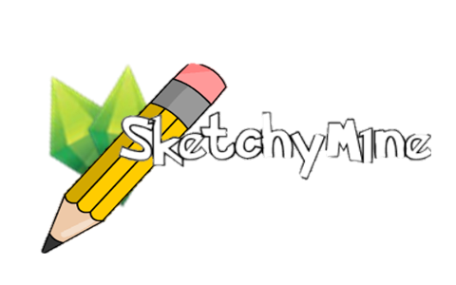
Sketchy Mine
DHI2V.So2

Slide 2





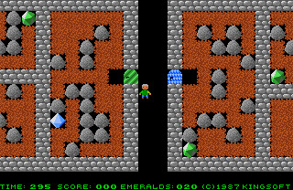


Core game idea
Web browser based
Online
Multiplayer/Multirole
Team-based
Ranking
Emerald Mine inspired
In game chatting
Moderation
Notes:
- We are making a web browser game so it won't use much computer resources, aka, wider audience because of tiny system requirements
- MMO makes people socialize. Thus, people motivate each other to play to game (since its also team-based), making it more addictive
- Ranking makes people compete against each other endlessly
- Most important concept: EMERALD MINE since it is asked by the publisher
- In game chatting making communication possible between the teams
- Moderation is used to avoid cheating by for example, kicking out a suspected cheater.
-Emerald mine based MMO can overwhelm the web browser
- No game engine is being used. Therefore easier to work on and making it fully functional

Slide 3
Gameplay
1 team draws, the other teams guess.
Infinite rounds of drawing and guessing.
This is all time based.
The guessing team that gets it correct first will dig the longest distance, followed by the runner ups then the losers.
The drawing team make sure their drawing is recognisable in order to earn digging points.
Each completed level is a shard.

Slide 4
Ranking
Total number of emeralds per player earned from the team based matches.
Each player in a team gets equal total number of shards.
If player leaves match before completing a level with the team, they lose the previously accumulated shards.
Basically, the ranking system keeps on from playing as much as possible. The more you play, the higher you go.

Slide 5
Differences from the proposed concept
Comparison:
Sketchy Mine is an MMO, large number of players.
Character is not controlled, progress bar is used instead.
Game is strictly team based, no single player available
Emeralds are earned through accumulating the shards.
Ranking system per individual player on the leader board.
Moderators can influence teams
Spectate-only mode
Original Idea integration:
Digging
Emeralds
Levels

Slide 6






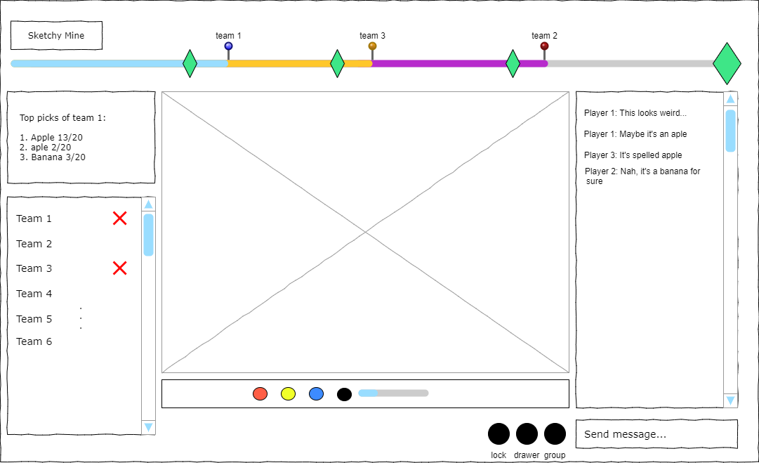


Wireframe
Emeralds
Level

Slide 7

Questions?

